Slide 1
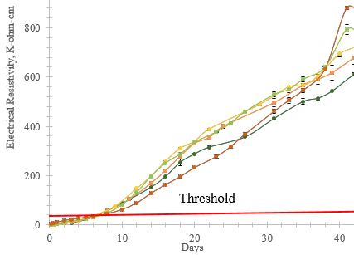
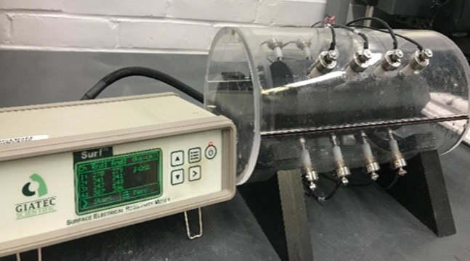
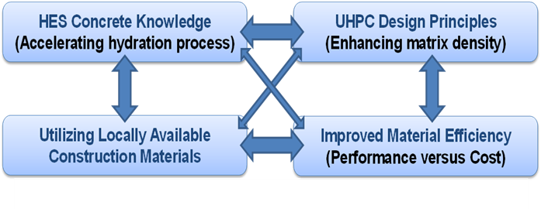
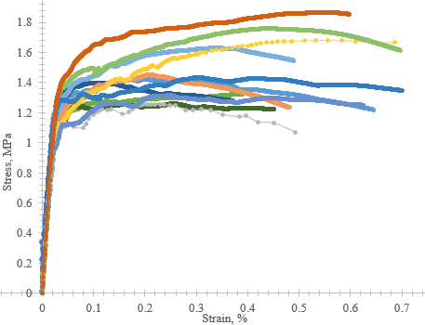
Development and Testing of High / Ultra-High Early Strength Concrete for Durable Bridge Components and Connections
Bijaya Rai, Ph.D. Student, Kay Wille, Ph.D. Associate Professor
Department of Civil And Environmental Engineering, University of Connecticut, Storrs, 06269
Motivation
Accelerated Bridge Construction (ABC) is a very popular construction method due to its time efficiency, structural reliability, cost and overall impact on the surrounding transportation system. Bridge joint elements are one of the
very critical elements in the ABC technology.
Methods
Ultra-High Performance Concrete (UHPC)
uses a relatively high binder ratio, a water to cementitious ratio (or water to binder ratio) less than 0.2,
compressive strength in excess of 150 MPa (22 ksi)
very high packing density leads to higher durability compared to conventional concrete
incorporates discontinuous fibers, leading to significantly higher ductility and durability of the cracked matrix
Sustainable infrastructure with enhanced life span
Aging of Infrastructure
Increased Traffic Loads
High Economical Impact
Results
Conclusion
Compressive strength of more than 150MPa after 28 days
Direct tensile strength (> 1.2 ksi) and strain at least more than 0.4% for all of the mixes
Electrical surface resistivity test (> 30 kohm–cm after 4d)
Able to reduce cost by ¼ th times of current proprietary UHPC
Future Work
Extensive investigation of durability properties such as freeze thaw durability, shrinkage and surface resistivity in newly developed New England UHPC
Plan to study of fiber efficiency
Acknowledgement
Figure 1: Batu 6 Bridge in Gerik – Perak, Malaysia
Figure 2: Cement replacement by slag
Figure 4: Electrical surface resistivity
Figure 3: Cement replacement by silica fume
Figure 5: Direct tension test

